Slide 1
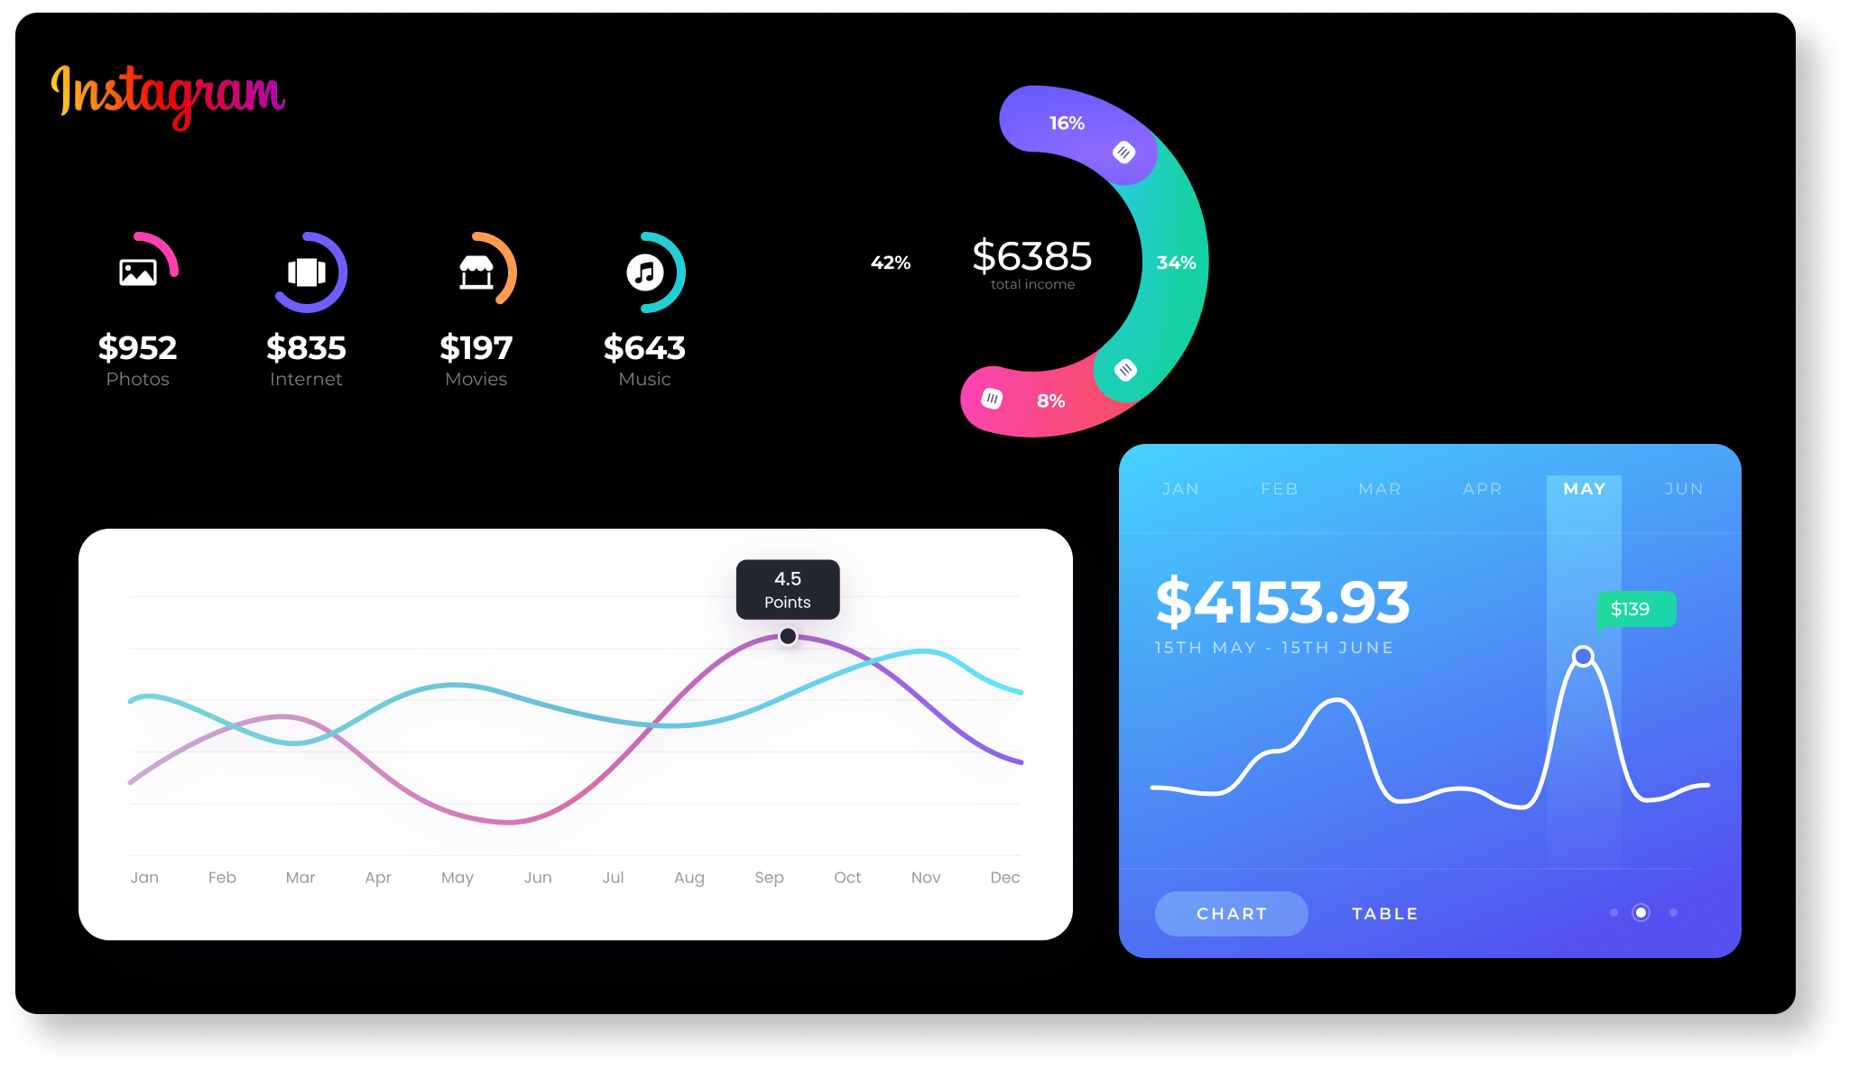
INSTAGRAM USER ANALYTICS
By MD. Nazish Taj

Slide 2

PROJECT DESCRIPTION: This project aims to analyze the raw data that is provided and retrieve useful insights from it by using SQL queries based on questions asked by the management team. Various database management tools can be used for this project.
PROJECT APPROACH: Using the provided RAW data to create a database in MYSQL Workbench and implementing various sorting and other queries for data extraction and valuable insights.
TECH-STACK USED: MySQL workbench, SQL queries , Microsoft PowerPoint

Slide 3
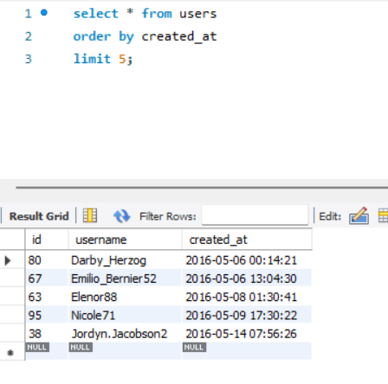
INSIGHTS:
A) Marketing:
Rewarding the Most Loyal Users: To find 5 oldest users of Instagram from the database provided
select * from users
order by created_at
limit 5;
Conclusion: Users with id 80 ,67,63,95,38 are 5 oldest users of Instagram

Slide 4
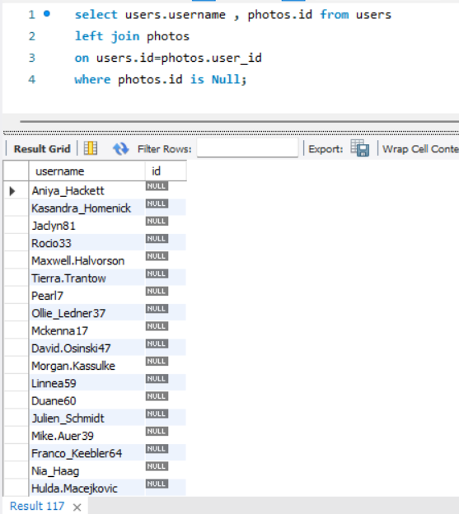

2. Remind Inactive Users to Start Posting: To find users who have never posted a single photo on Instagram.
select users.username , photos.id
from users
left join photos
on users.id=photos.user_id
where photos.id is Null;
Conclusion: Above mentioned users haven’t posted a single photo on Instagram.

Slide 5
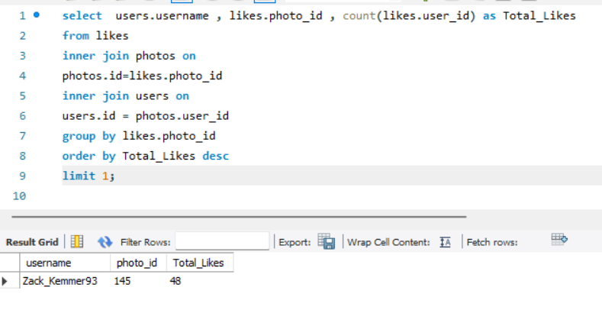

3. Declaring Contest Winner: To find which user got most likes on a single photo
select users.username , likes.photo_id ,
count(likes.user_id) as Total_Likes
from likes
inner join photos on photos.id=likes.photo_id
inner join users
on users.id = photos.user_id
group by likes.photo_id
order by Total_Likes desc
limit 1;
Conclusion: Photo_ID 145 is the photo got with most likes posted by username Zack_Kemmer93.

Slide 6

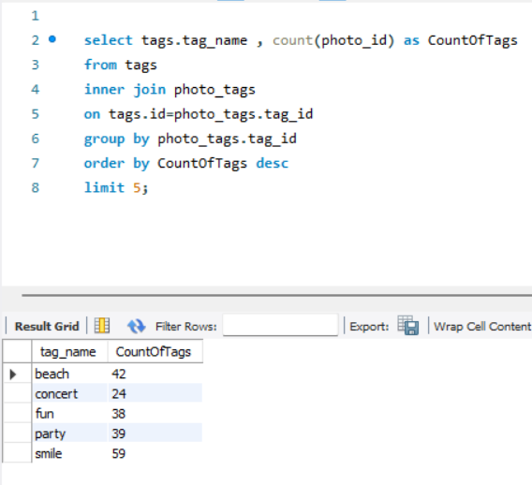
4. Hashtag Researching: To identify and suggest Top 5 most commonly used tags on the platform.
select tags.tag_name ,
count(photo_id) as CountOfTags
from tags
inner join photo_tags
on tags.id=photo_tags.tag_id
group by photo_tags.tag_id
order by CountOfTags desc
limit 5;
Conclusion : smile , beach , party , fun and concert are the most used hashtags on the platform.

Slide 7
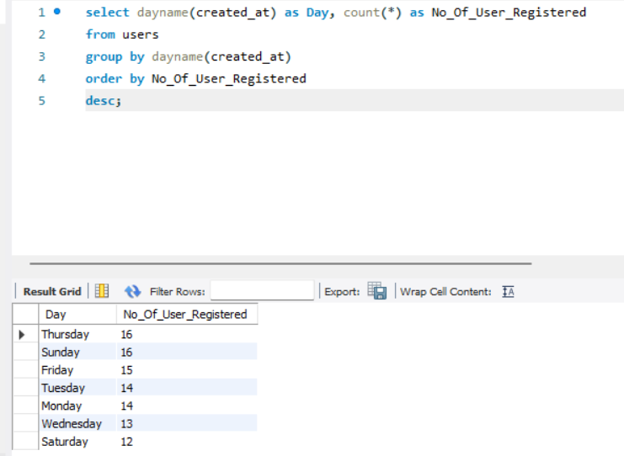
5. Launch AD campaign: To find which day most user registers on the platform.
select dayname(created_at)
as Day,
count(*) as No_Of_User_Registered
from users
group by dayname(created_at)
order by No_Of_User_Registereddesc;
Conclusion: Most user registers on Thursday and Sunday.

Slide 8
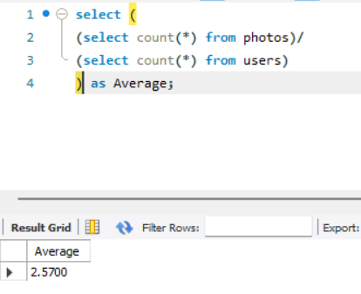

B)INVESTOR METRICS
1. User Engagement: To find how many time on avg user post photos and also to show total no of photos and total no . of users.
select (
(select count(*) from photos)/
(select count(*) from users)
) as Average;
Conclusion : Average photos uploaded by user is 2.5700

Slide 9

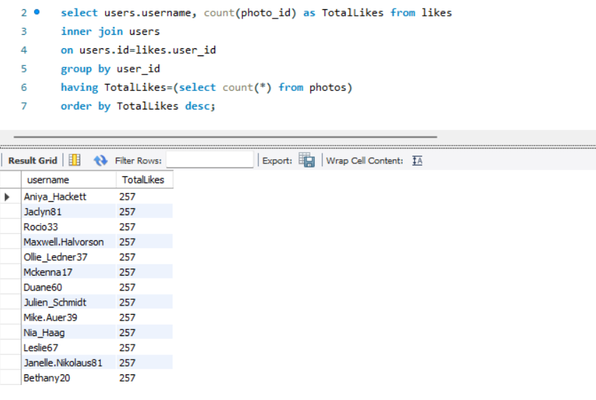
2. Bots & Fake account: Identify users (potential bots) who have liked every single photo on the site, as this is not typically possible for a normal user..
select users.username,
count(photo_id) as TotalLikes
from likes
inner join users
on users.id=likes.user_id
group by user_id
having TotalLikes=(select count(*) from photos) order by TotalLikes desc;
Conclusion: Above mentioned users liked every single photos.

Slide 10
THANK YOU
By MD. Nazish Taj

